Slide 1


IBM
QRadar SIEM Threat Management

Slide 2




Content
SOC Analyst
Security Information and Event Management
IBM QRadar
U.S. Census Project Triage

Slide 3


SOC Analyst
Security Operations Center (SOC) Analyst is the first line of defense in an organization, and if a SOC analyst fails to identify an adversary, no one else in the organization can find it out.
They report threats to the second line of defense and then implement security strategies to protect the organization.

Slide 4
Responsibilities of SOC Analyst
Monitor
Monitor security access
Conduct
Conduct security assessments
Analyze
Analyze the breach to reach the root cause
Perform
Perform internal and external security audits
Advise and implement
Advise and implement necessary security protocols

Slide 5
SIEM
SIEM stands for Security Information and Event Management.
It consists of 2 parts:
SIM - retrieves and analyzes log data and generates a report.
SEM - which carries out analysis of event and log data in real-time to provide event correlation, threat monitoring an incident response.
SIEM works by collecting log and event data generated by the assets throughout the network.

Slide 6
Benefits of SIEM
Increased efficiency
Preventing potential security threats
Reducing the impact of security breaches
Reducing costs
Better reporting, log analysis and retention

Slide 7





Companies providing SIEM product

Slide 8




IBM QRadar
QRADAR IS A SECURITY INFORMATION AND EVENT MANAGEMENT OR SIEM PRODUCT THAT IS DESIGNED FOR ENTERPRISES.
CORRELATE RELATED ACTIVITIES TO PRIORITIZE INCIDENTS
AUTOMATICALLY PARSES AND NORMALIZES LOGS
INTEGRATES OUT-OF-THE-BOX WITH 450 SOLUTIONS

Slide 9






Questions answered by QRadar
WHAT IS BEING ATTACKED?
WHAT IS THE SECURITY IMPACT?
WHO IS ATTACKING?
WHERE TO INVESTIGATE?
WHEN ARE THE ATTACKS TAKING PLACE?
HOW IS THE ATTACK PENETRATING THE SYSTEM?
IS THE SUSPECTED ATTACK OR POLICY BREACH REAL OR A FALSE ALARM?

Slide 10





Components of QRadar
DASHBOARD
OFFENSES TAB
LOG ACTIVITY
NETWORK ACTIVITY
ASSETS
ADMIN TAB

Slide 11
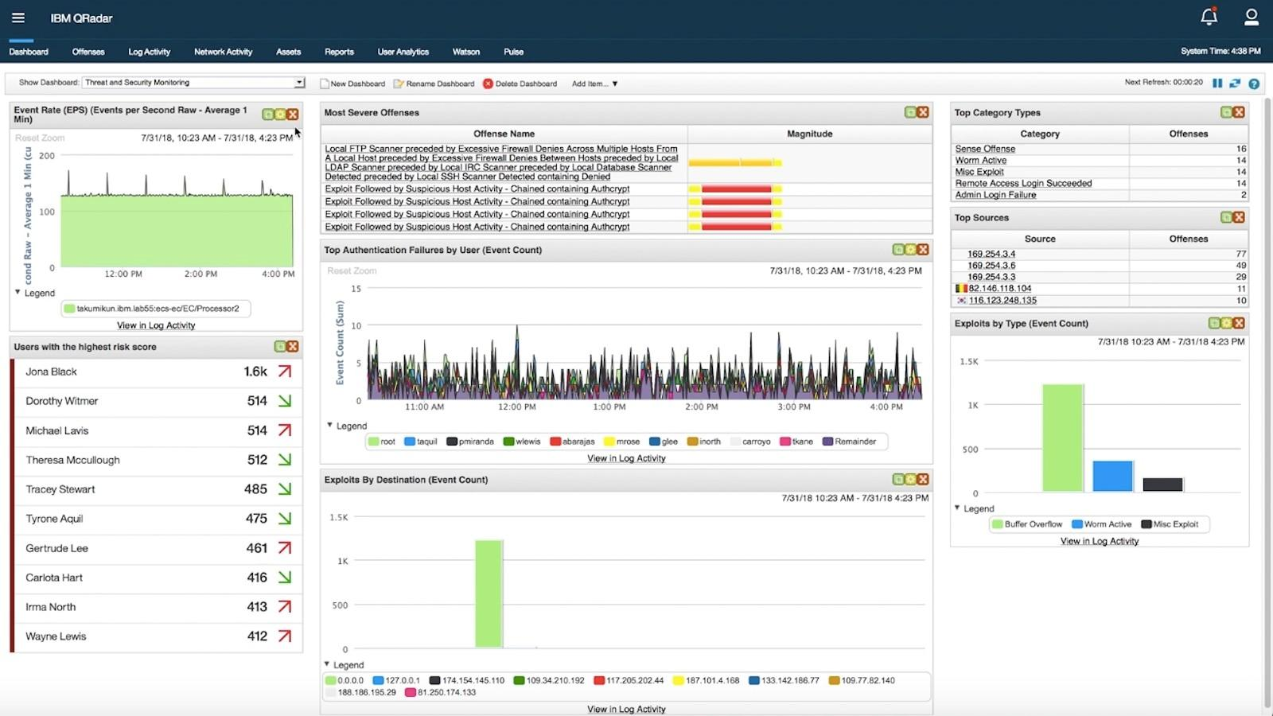
Dashboard

Slide 12
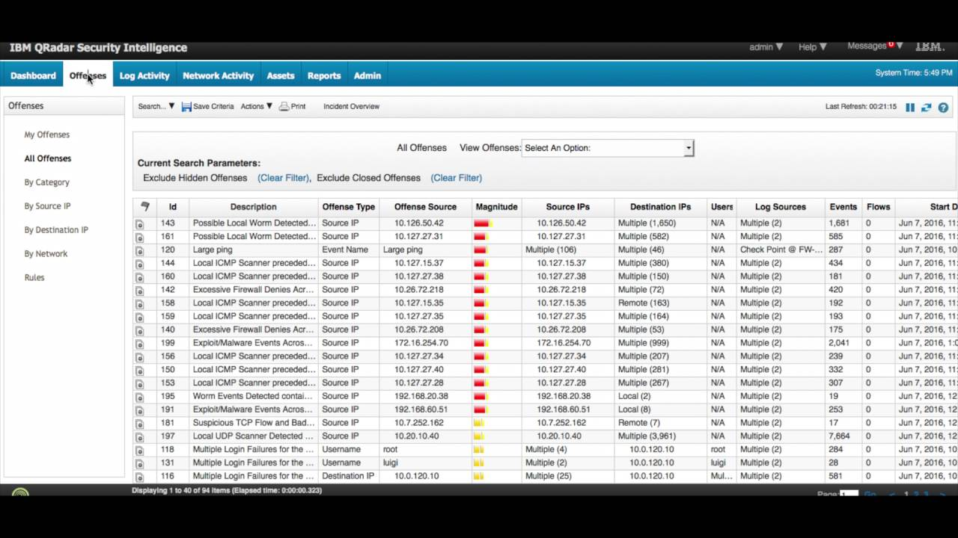
Offenses Tab

Slide 13
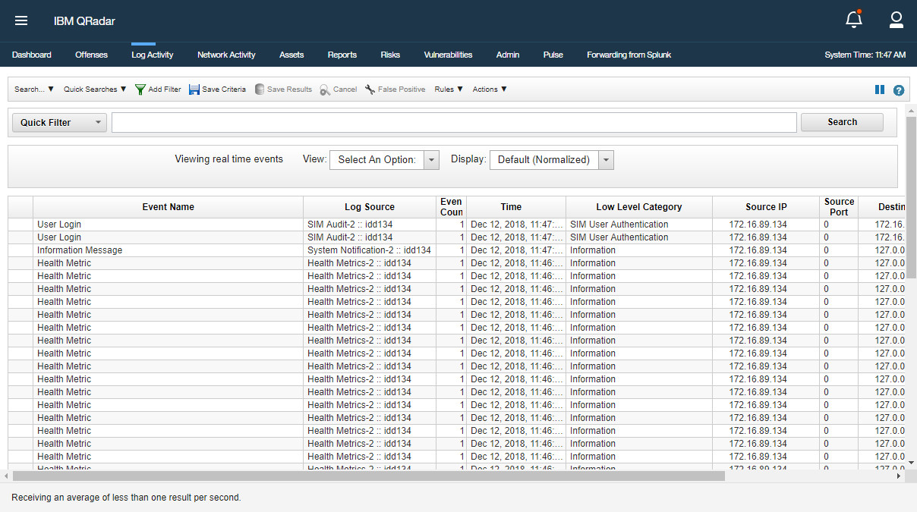
Log Activity Tab

Slide 14
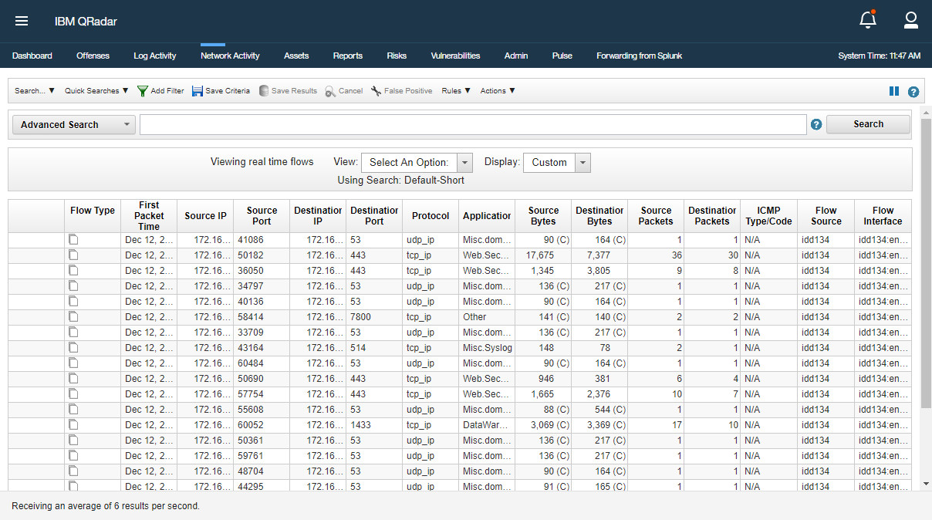
Network Activity Tab

Slide 15
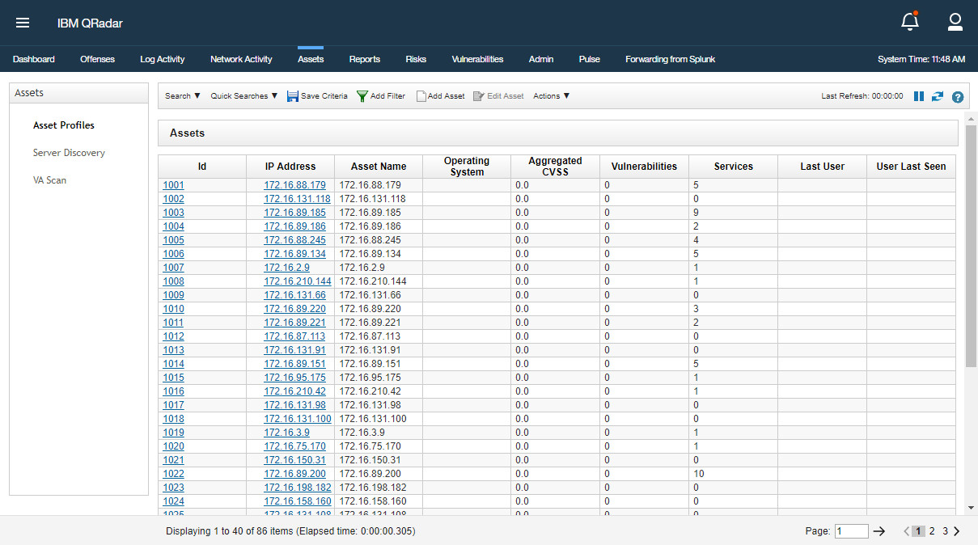
AssetsTab

Slide 16
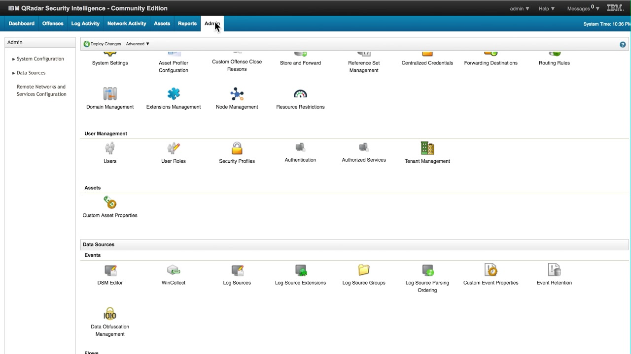
Admin Tab

Slide 17
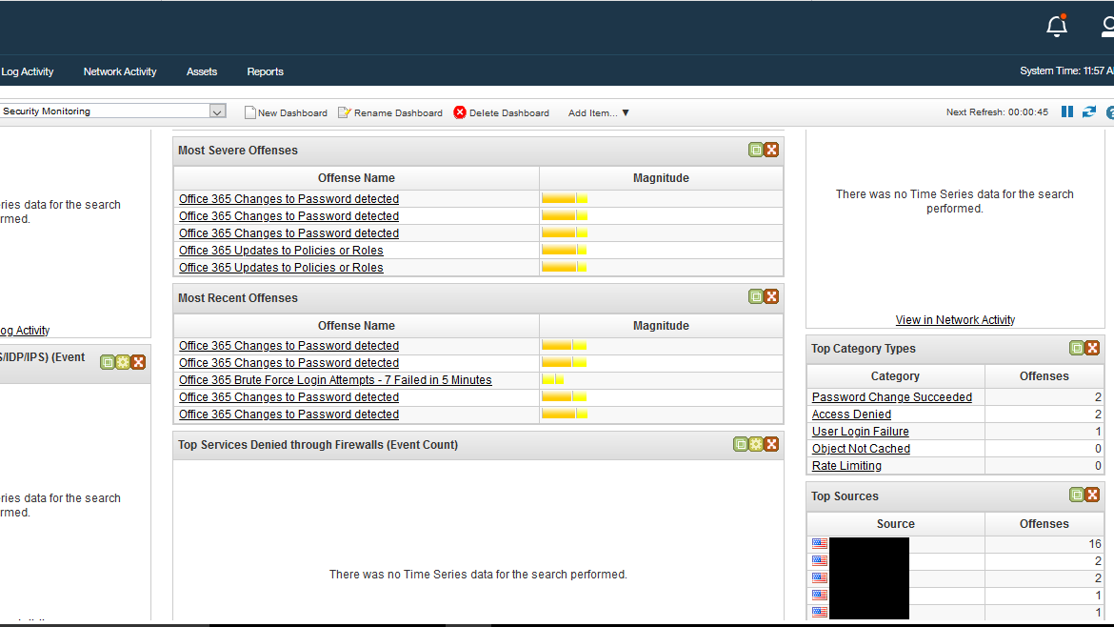
U.S. Census Project Triage (State of California)
Evaluating the previous investigation reports by Wavestrong SOC Analysts.
*Note: Some information has been blacked out due to privacy/security reasons.

Slide 18
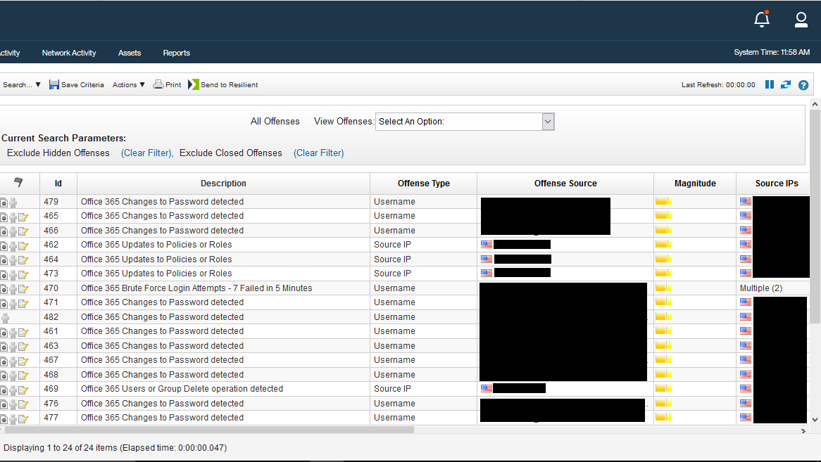
Census Offenses Tab

Slide 19
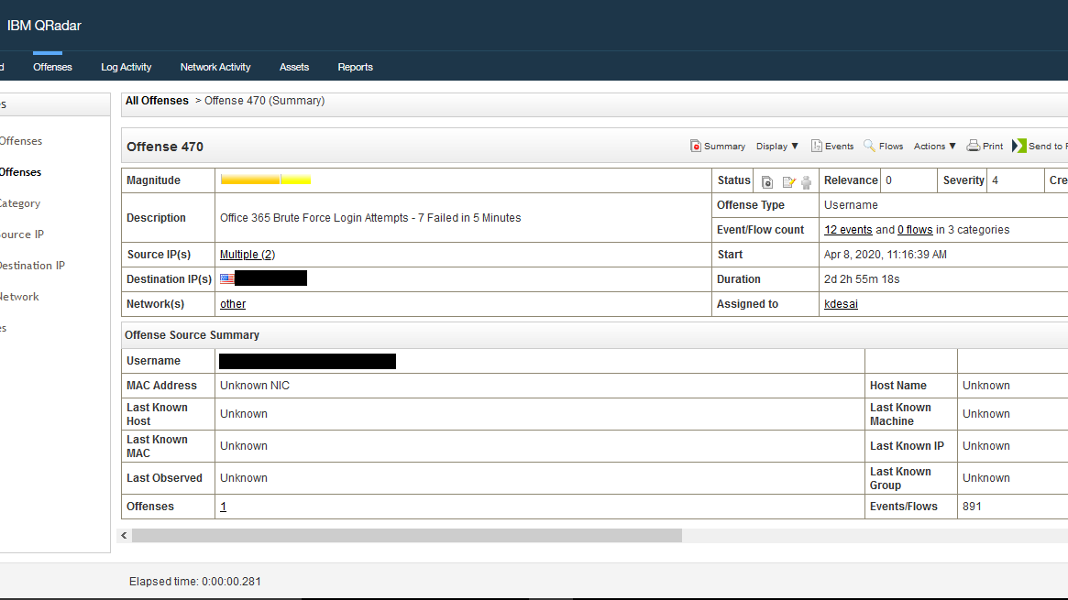
Login Failure Summary

Slide 20
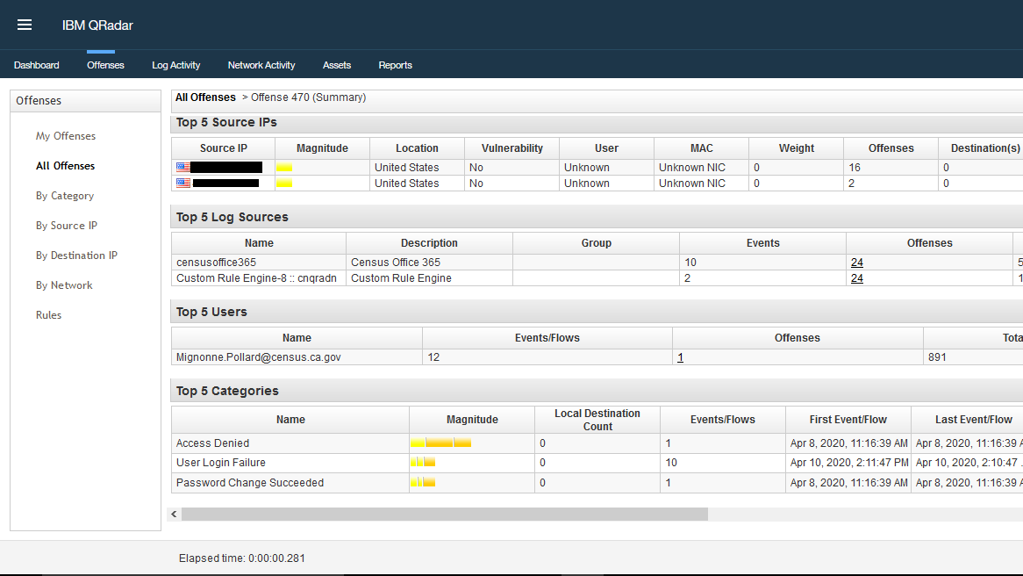
Continued...

Slide 21
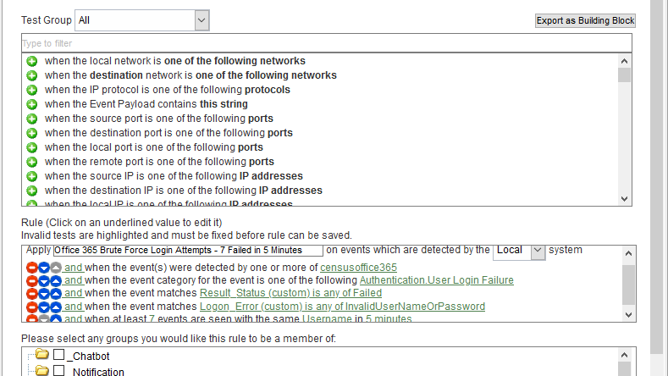
Rules Triggering the Offense

Slide 22
Thank You !

